Slide 1


HOW TO RECOGNIZE AND PROTECT YOURSELF FROM ONLINE SCAM
This Photo by Unknown Author is licensed under CC BY-SA

Slide 2

INTRODUCTION
Phishing is a cybercrime where attackers attempt to trick individuals into revealing sensitive information or taking harmful actions by disguising themselves as trustworthy entities.
This Photo by Unknown Author is licensed under CC BY-SA

Slide 3

TYPES OF PHISHING
Email Phishing: Fraudulent emails that appear to be from legitimate organizations.
Spear Phishing: Targeted attacks against specific individuals or organizations.
Smishing: Phishing attempts via text messages.
Vishing: Phishing attempts through phone calls.
This Photo by Unknown Author is licensed under CC BY-NC
This Photo by Unknown Author is licensed under CC BY-SA

Slide 4

RED FLAGS TO RECOGNIZE PHISHING ATTEMPTS
Email warning signs: Spelling and grammatical errors
Website warning signs: URLs that look similar to but not exactly like legitimate sites
Social engineering tactics: Offering unrealistic rewards or prizes
This Photo by Unknown Author is licensed under CC BY-SA

Slide 5

PROTECTIVE MEASURES
Use email filtering and antivirus software
Enable two-factor authentication
Always keep software and systems updated
This Photo by Unknown Author is licensed under CC BY-SA

Slide 6
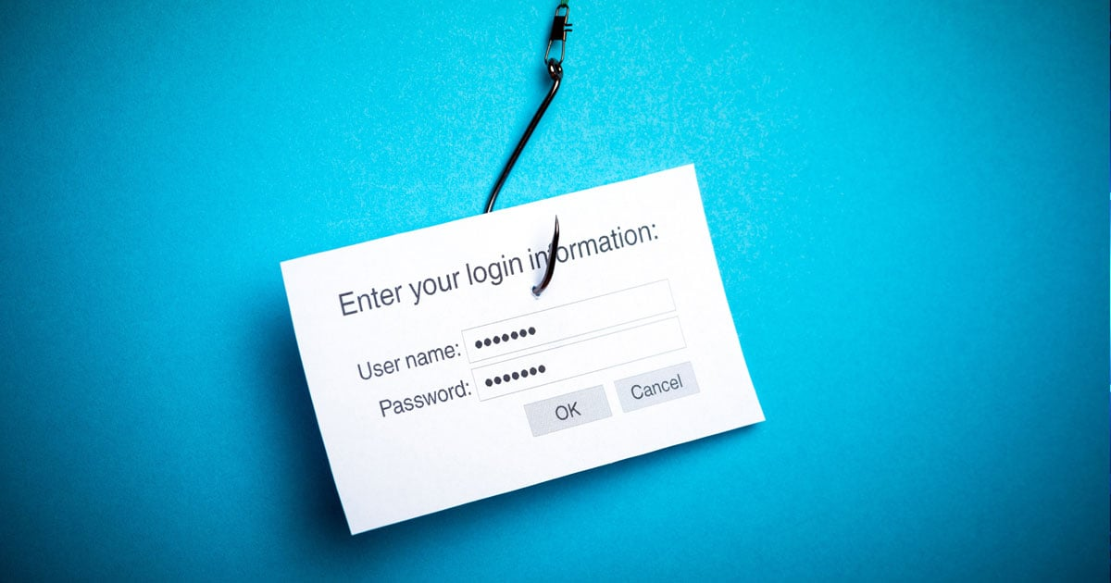
WHAT TO DO IF YOU SUSPECT A PHISHING ATTEMPT
Report the attempt to the appropriate authorities.
Do not download attachments.
Change passwords for potentially compromised accounts.
This Photo by Unknown Author is licensed under CC BY-SA
This Photo by Unknown Author is licensed under CC BY-SA

Slide 7
CONCLUSION
Staying informed and vigilant is your best defense against phishing attacks. Always think before you click, verify sources, and trust your instincts.
This Photo by Unknown Author is licensed under CC BY-SA

Slide 8
THANKS!
Ijongo Victory Gogo
This Photo by Unknown Author is licensed under CC BY-SA

